Slide 1
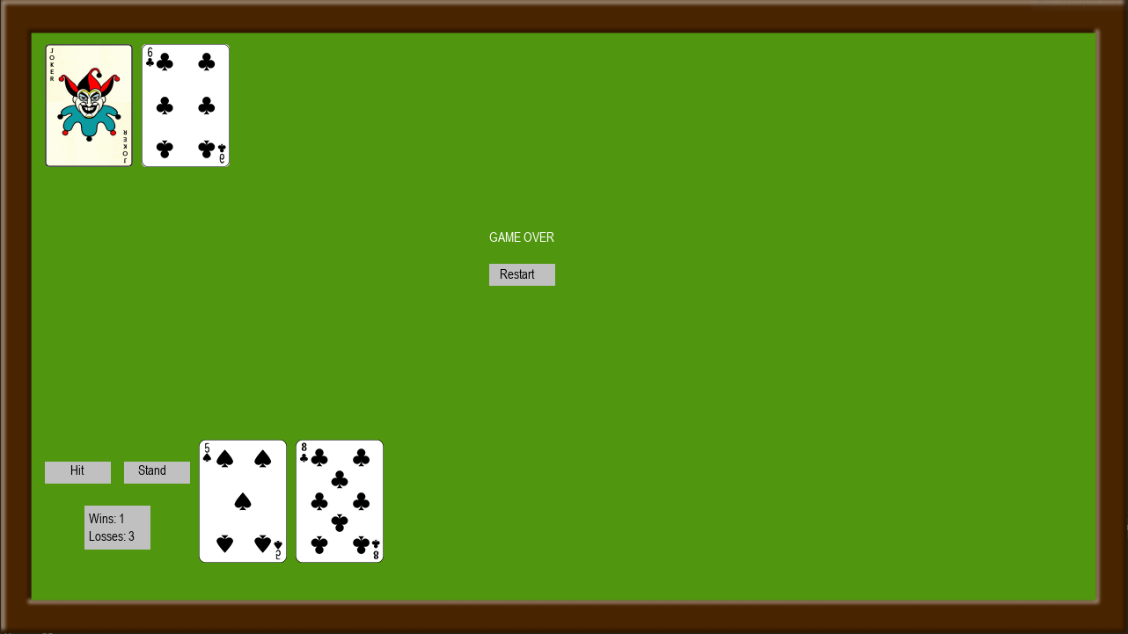
BlackjackGUI
The classic card game made in PyGame – now with a Joker mode!
Jacob Shikany
https://github.com/ksu-is/Simple-Blackjack-Game-GUI

